Slide 1
Movie Streaming Platform Analytics
Data-driven insights for user engagement and content trends
Jonathan Olu Oyekola

Slide 2
Project Overview
Objective: Analyze user watch history and movie metadata to identify trending content, popular genres, and viewing patterns.
Data Sources:
TMDB API - for movie metadata
Simulated CSV logs - user watch history

Slide 3
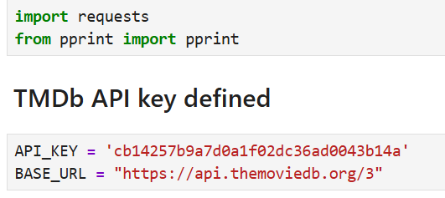
Data Collection
Python script to fetch movie metadata and watch statistics
Fetch movie metadata - title, genre, rating, release date - from TMDB API.
Load user watch history from CSV logs.
Key Libraries: pandas, requests, sqlalchemy

Slide 4
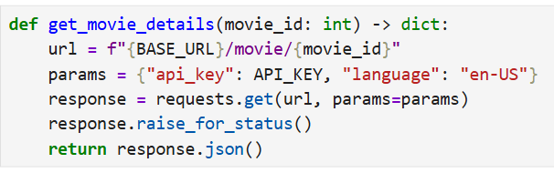
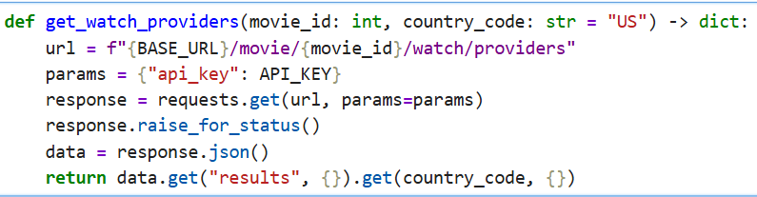
Fetch movie detail from TMDb
Fetch watch provider by Country

Slide 5
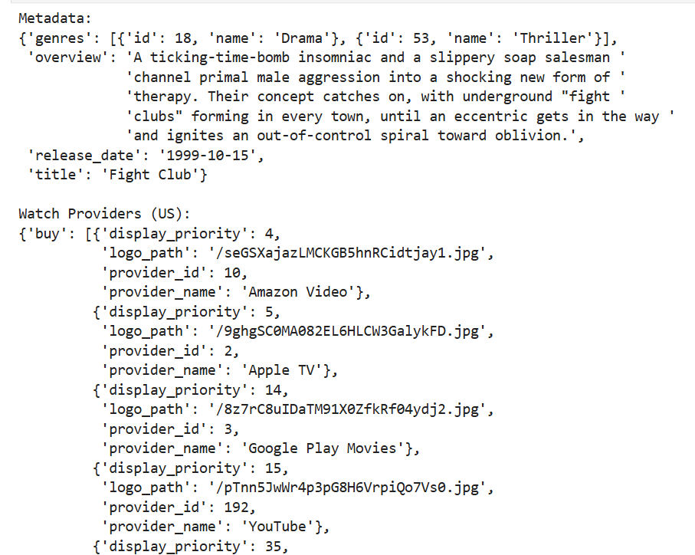
Output

Slide 6
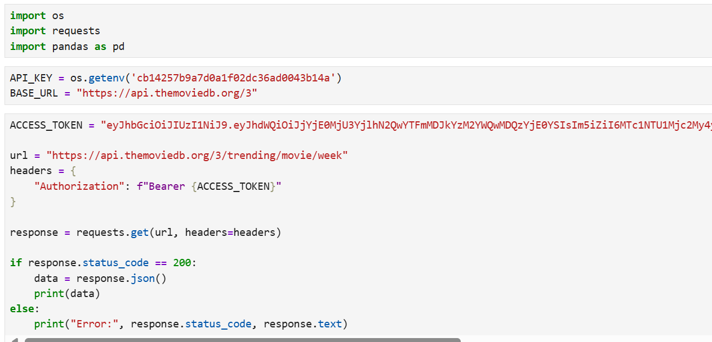
Transformation logic to identify trending genres and top-rated titles
Goals: Identify trending genres, Determine top-rated titles & Analyze viewing patterns by time
Key Libraries: pandas, requests, os

Slide 7
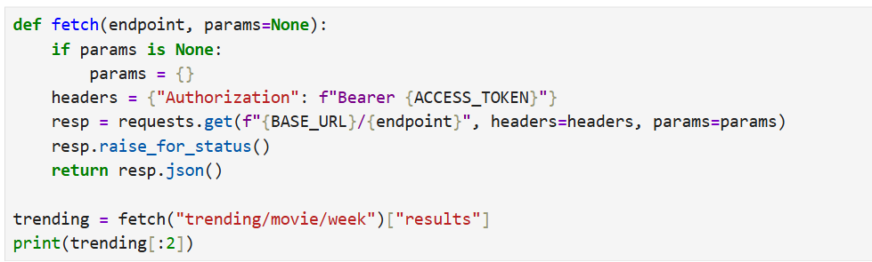
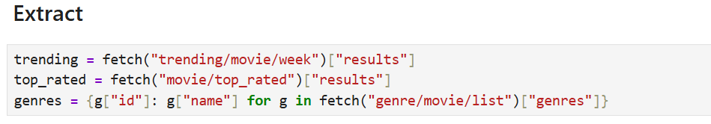

Slide 8
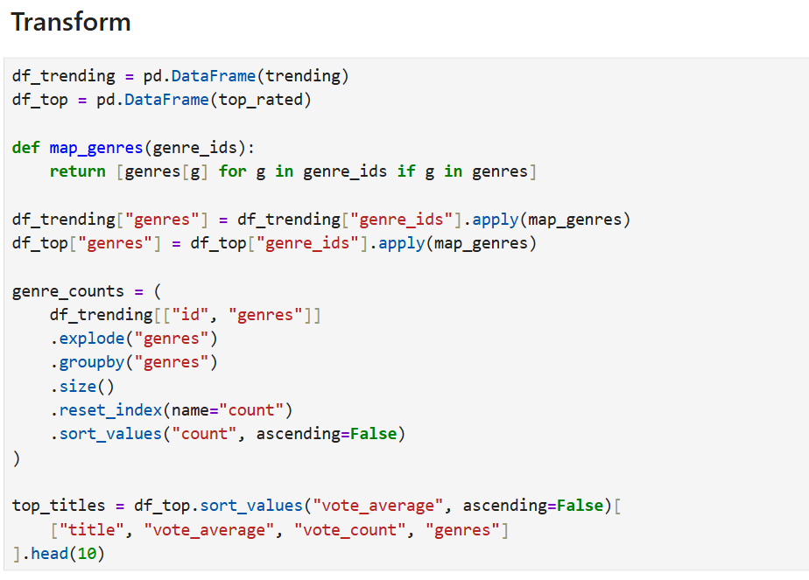

Slide 9
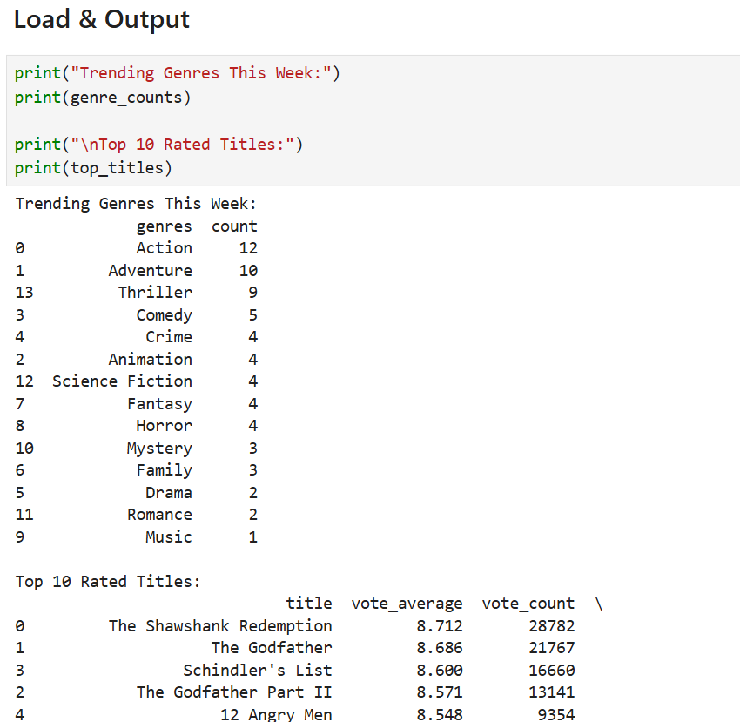

Slide 10
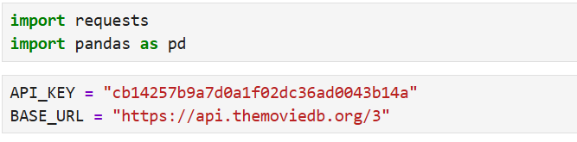
PostgreSQL schema for movies, users, and watch sessions
PostgreSQL tables:
1. movies:| movie_id | title | genre | release_date | rating | ...
2. users:| user_id | name | email | signup_date | ...
3. watch_sessions:| session_id | user_id | movie_id | watch_date | watch_time | duration | ... |
Key Libraries: pandas, requests

Slide 11
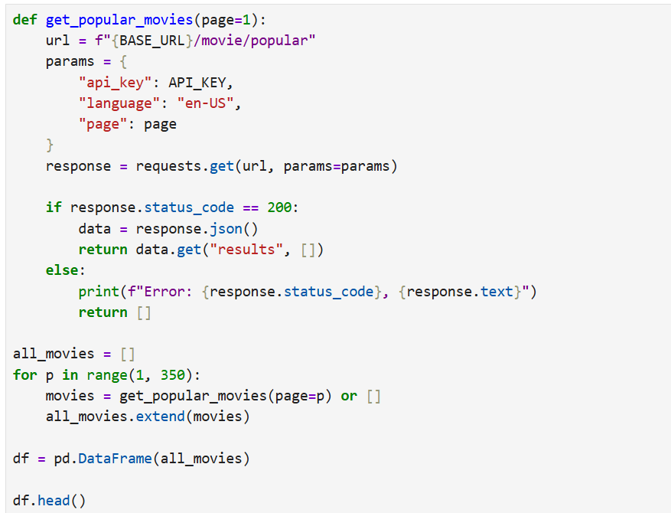

Slide 12
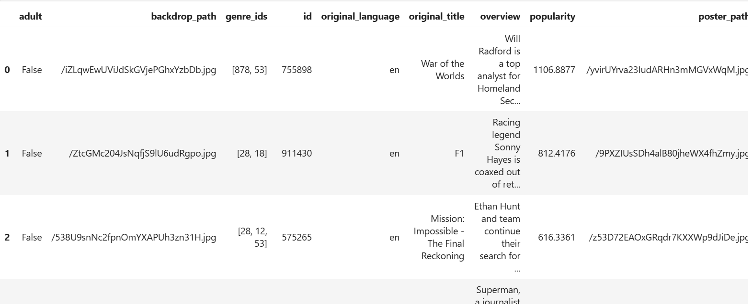
Output

Slide 13
Analytics & Insights
Metrics:
Top 10 trending movies
Genre popularity over time
Viewing patterns by time of day
Visualizations:
Bar chart: Top 10 movies
Line chart: Genre popularity over months
Heatmap: Viewing activity by hour

Slide 14
Grafana Dashboard
Components:
Top 10 Trending Movies: Bar chart with counts
Genre Popularity Over Time: Line chart per genre
Viewing Patterns by Time of Day: Heatmap - hour vs day
Example Queries for Grafana:
## Top 10 movies
SELECT title, COUNT(*) as views
FROM watch_sessions ws
JOIN movies m ON ws.movie_id = m.movie_id
GROUP BY title
ORDER BY views DESC
LIMIT 10;

Slide 15
Conclusion & Next Steps
Key Insights:
Most popular genres
Peak viewing hours
Highly rated content trends
Next Steps:
Predict trending movies using ML
Integrate real-time streaming logs

